Slide 1
Data Science Project for WAVE Volleyball
By Prithvi Balaji
12/30/2019

Slide 2
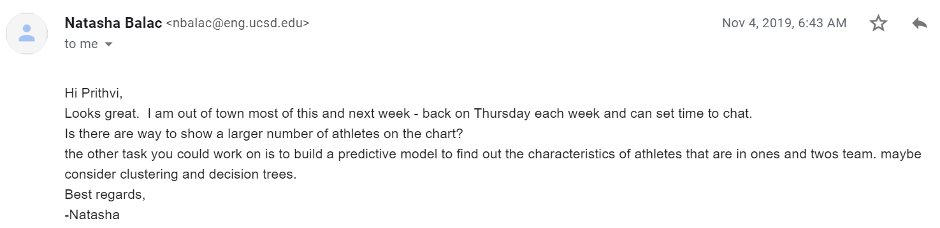
Goals

Slide 3
Goals
Dataset
KNIME workflow
Predictive models: Decision Tree and Clustering
Team – Ones & Twos
Attributes: Jump, App Vertical, Speed, Height and Reach

Slide 4
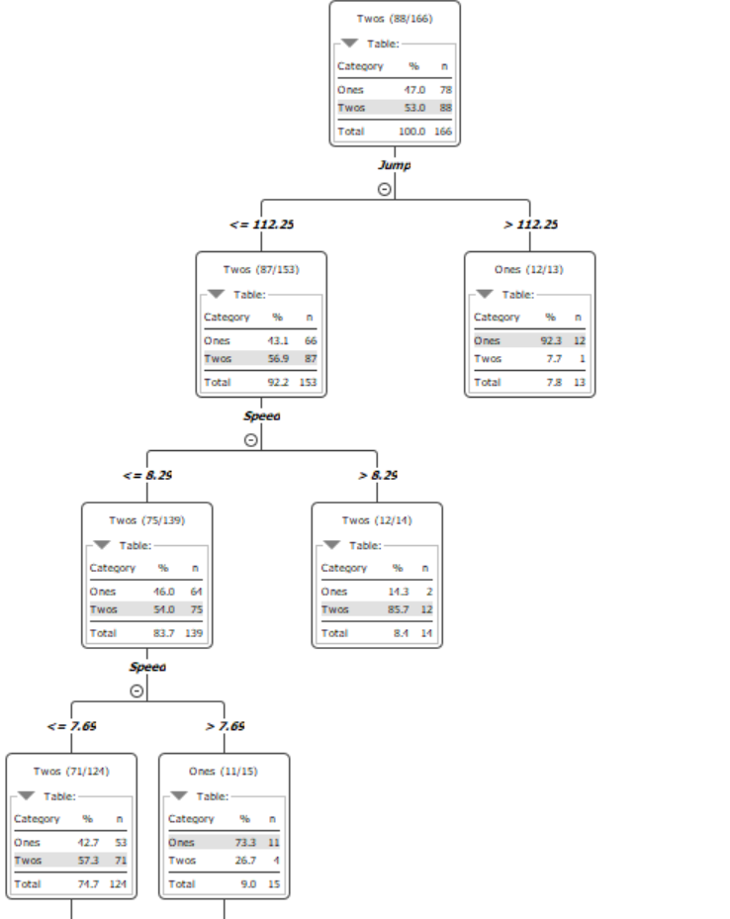
Decision Tree

Slide 5
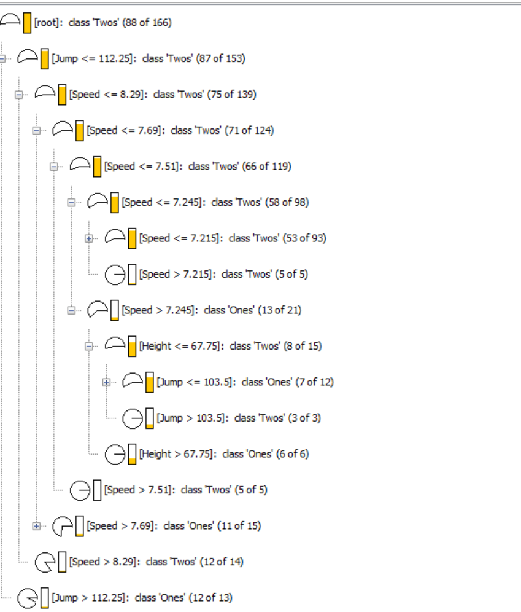
Simple Decision Tree

Slide 6
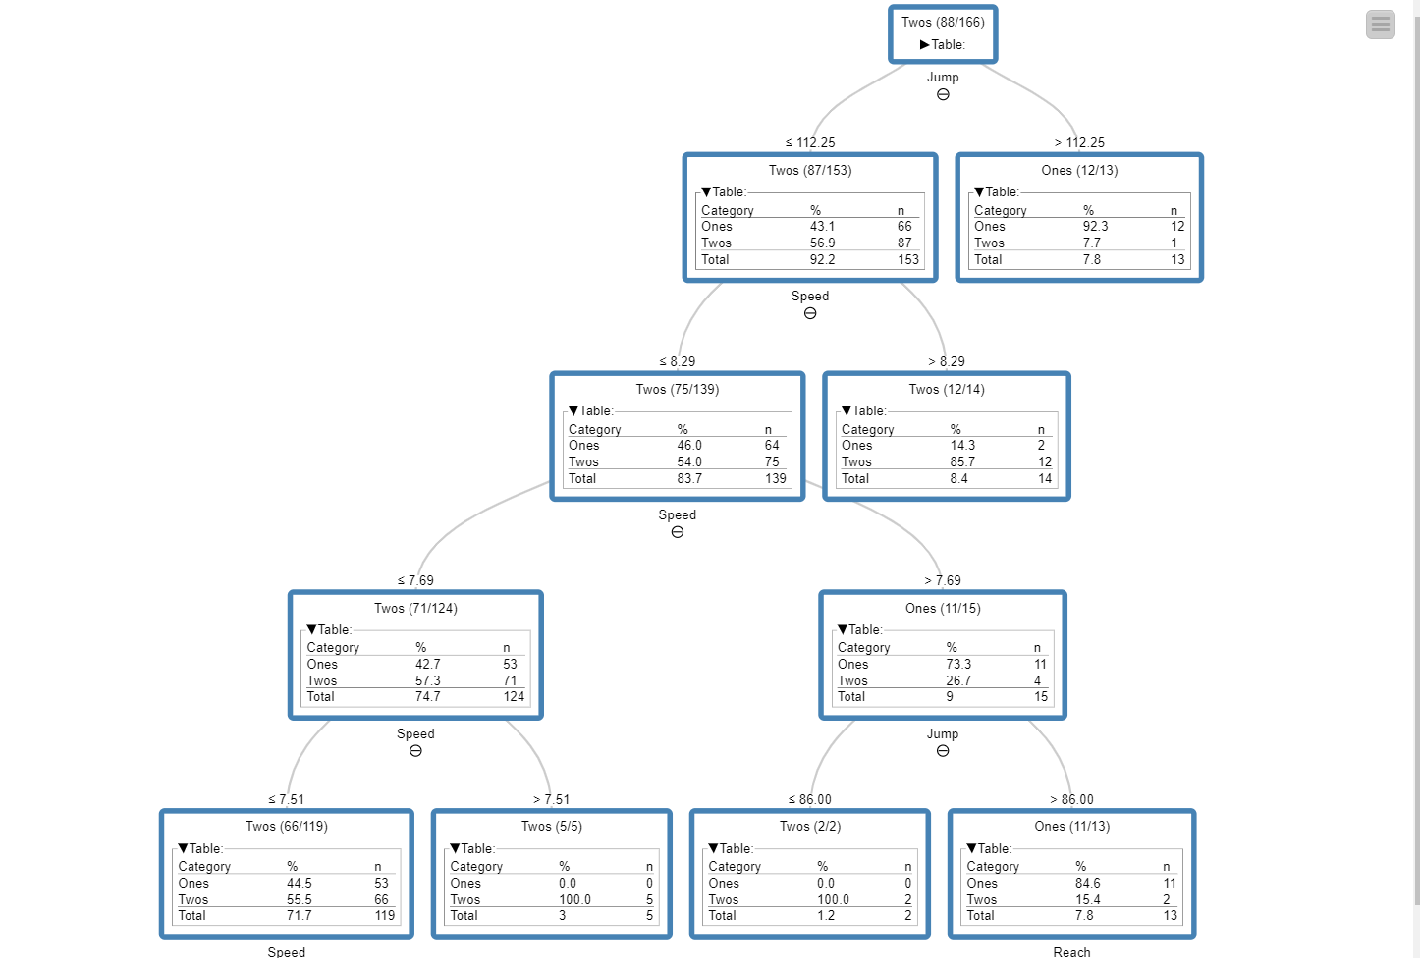
Interactive Decision Tree

Slide 7
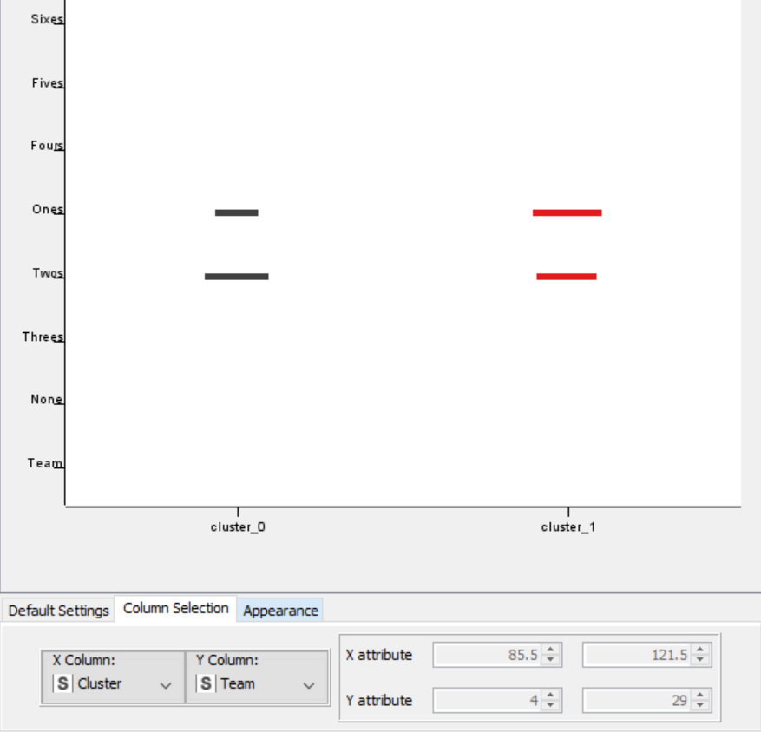
Scatter Plot
Cluster v Team

Slide 8
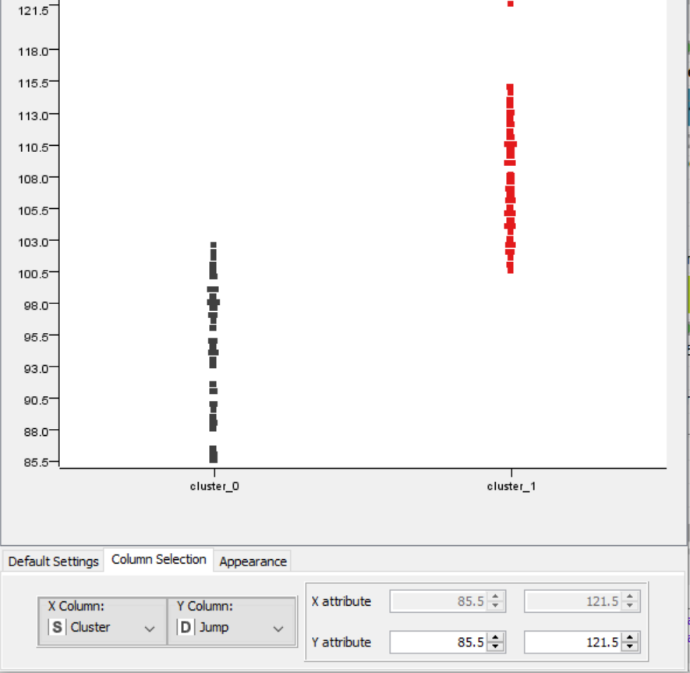
Scatter Plot
Cluster v Jump

Slide 9
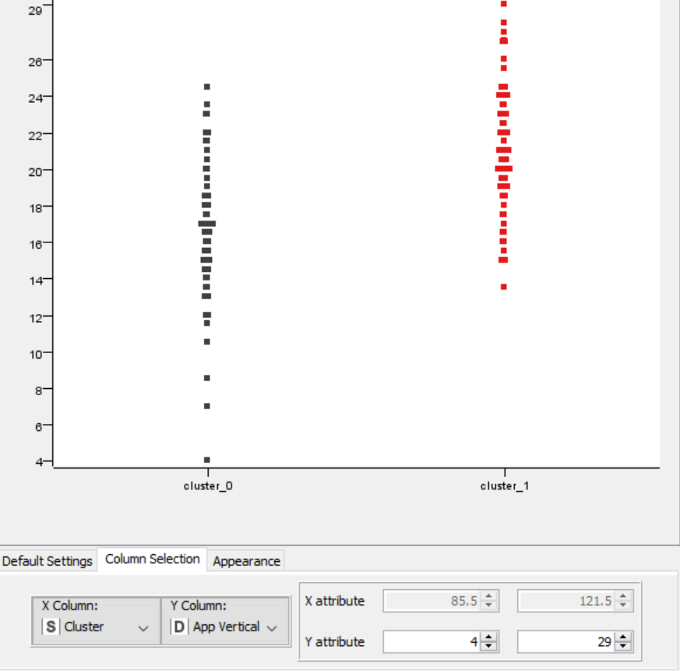
Scatter Plot
Cluster v App Vertical

Slide 10
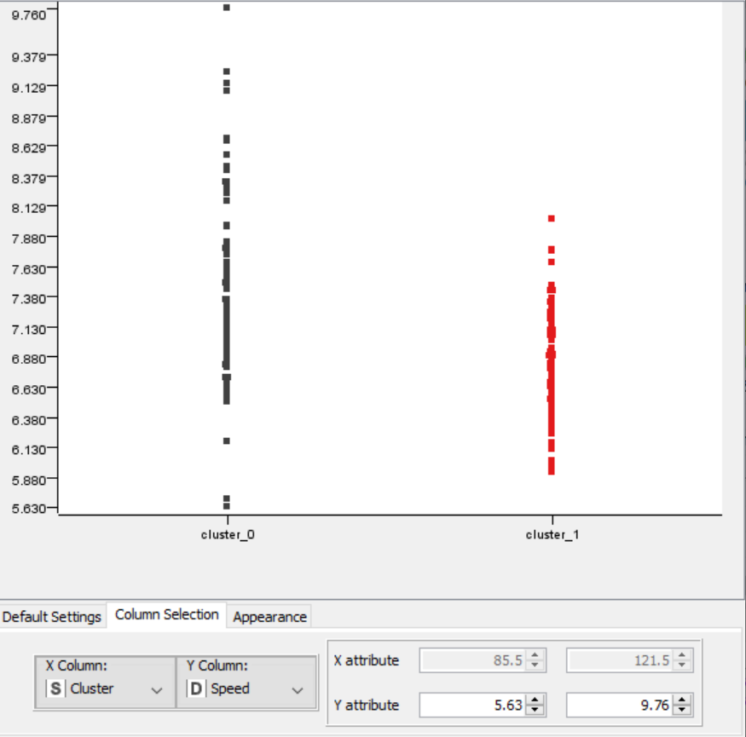
Scatter Plot
Cluster v Speed

Slide 11
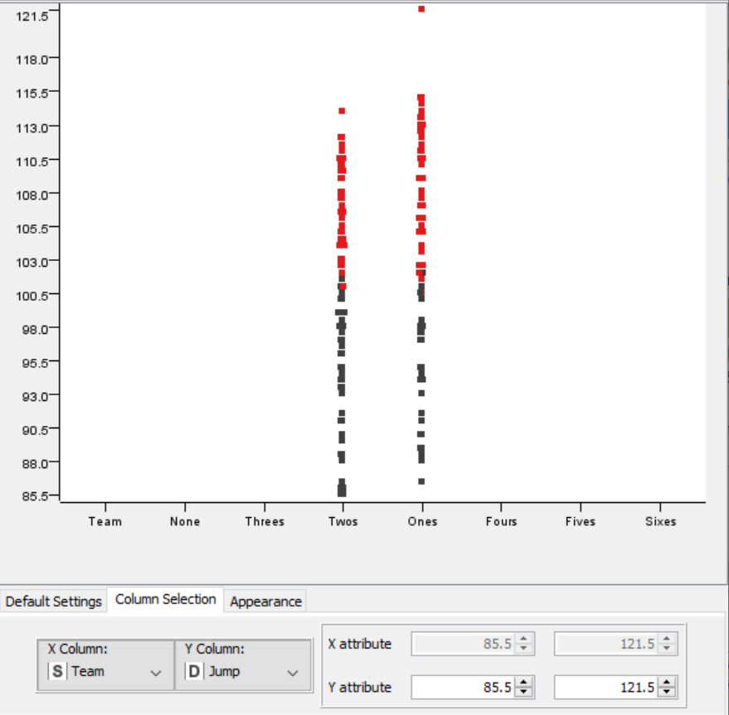
Scatter Plot
Team v Jump

Slide 12
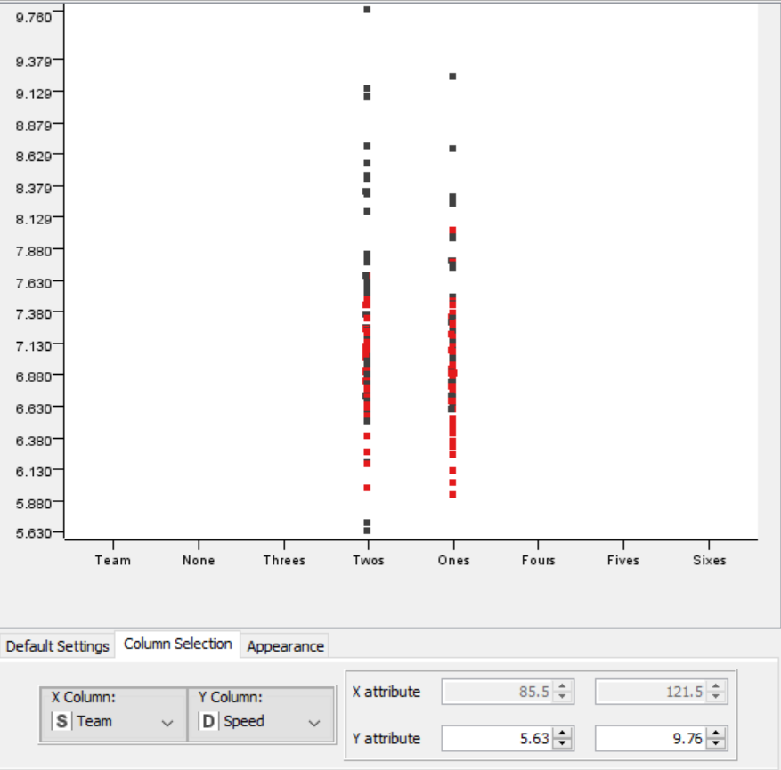
Scatter Plot
Team v Speed

Slide 13
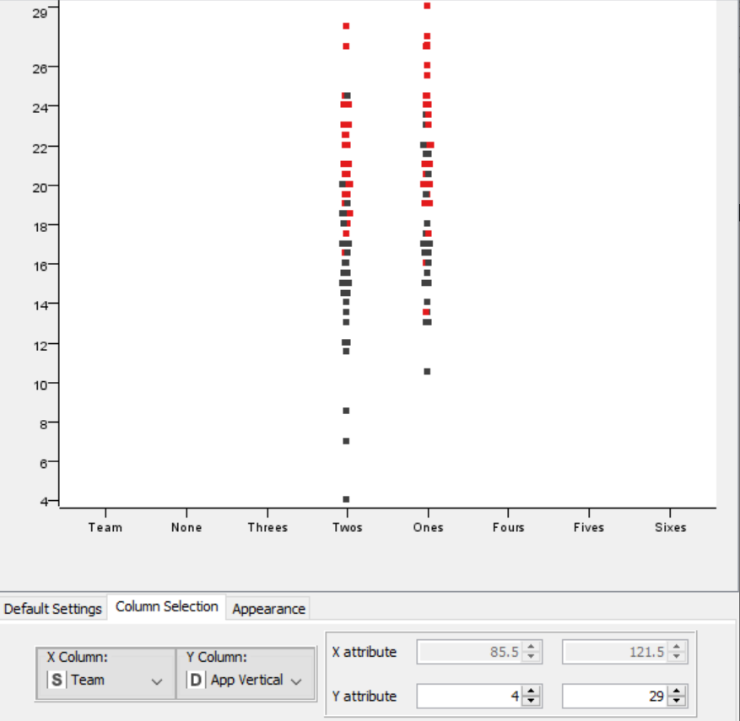
Scatter Plot
Team v App Vertical

Slide 14
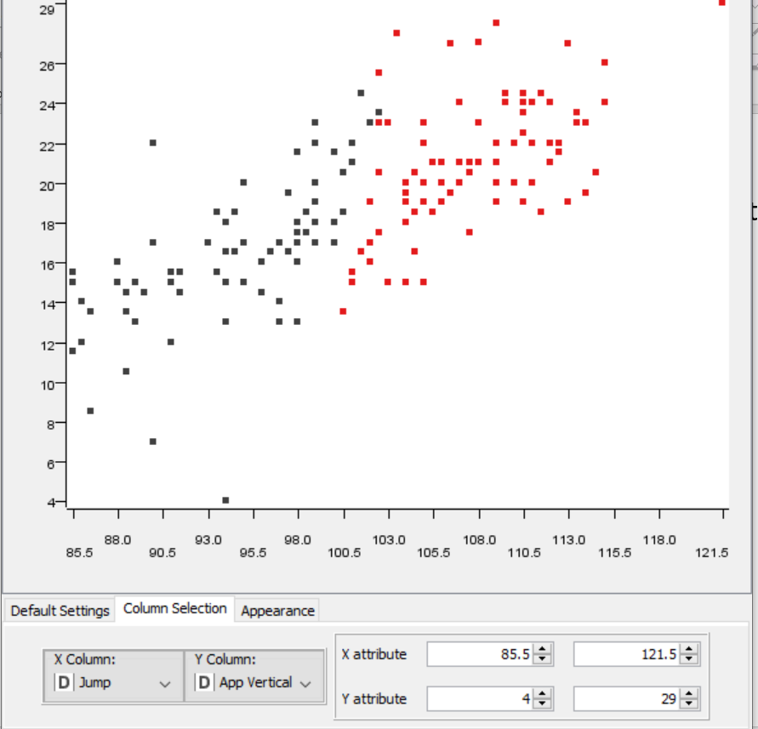
Scatter Plot
Jump v App Vertical

Slide 15
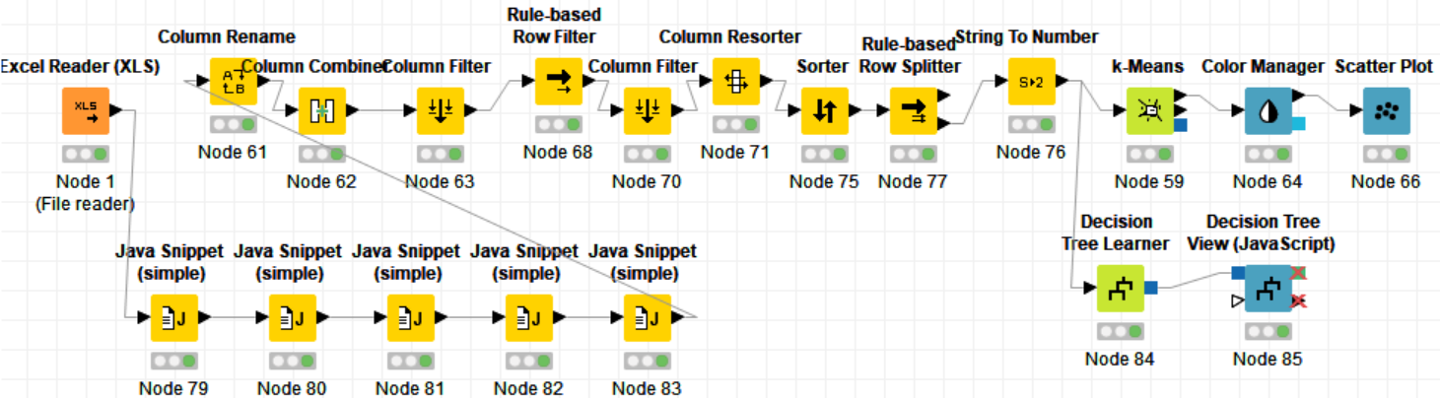
Work Flow

Slide 16
My observations so far from Decision Tree..
Making the Ones team is predicated by the Jump attribute (Near 92 percent on Ones team had >112.25 )
Speed was merely a indicator of Ones/Twos team
If an athlete had lower than a 7.7 Speed time, it came back to their Reach and their Jump

Slide 17
My observations so far from Clustering..
In the Cluster v Speed, there is much more variance in the Twos Team
In the Team v Jump, the Twos team tended to fill the bottom of the graph and Ones team tended to fill the top, resulting in Jump being a clear indicator of team decisions
In the Cluster v App Vertical, there is many outliers in the Twos Team

Slide 18
Next steps..
Need Dr. Balac’s input & suggestions
Expand model to include game attributes (Hit, Throw, Serve etc)
Test predictive models with sample data
Complete visualization of athletes from 10u to 16u in Team 1s and 2s

